Slide 1

Buffer 3.0
JUST-IN
TEAM : JUST-IN-JAVA
Shreya Amritkar
Aishwarya Andhale
Sakshi Bhosale
Rasika Devanhalli

Slide 2
Problem Statement
TRAVEL PLANNER
Implementing Dijkstra's algorithm to compute the shortest distance between two cities using Graph as the data structure.

Slide 3
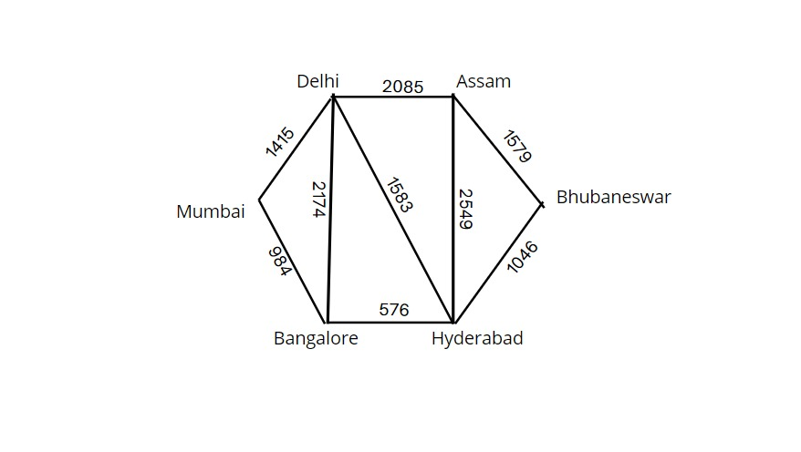
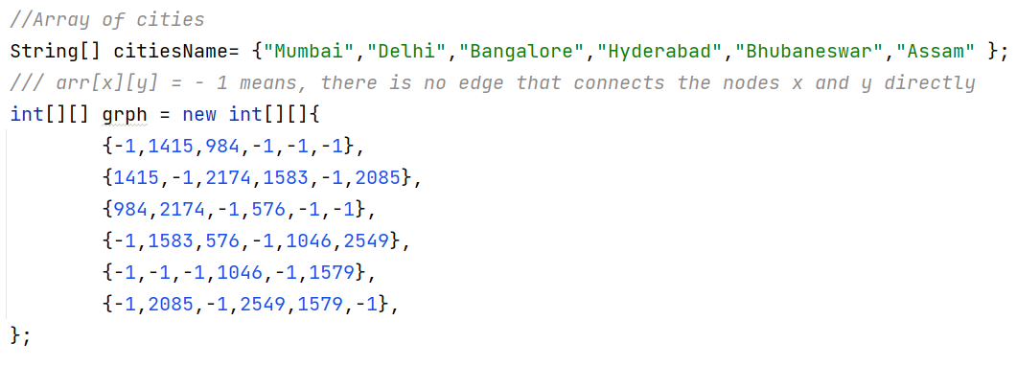
JUST-IN

Slide 4
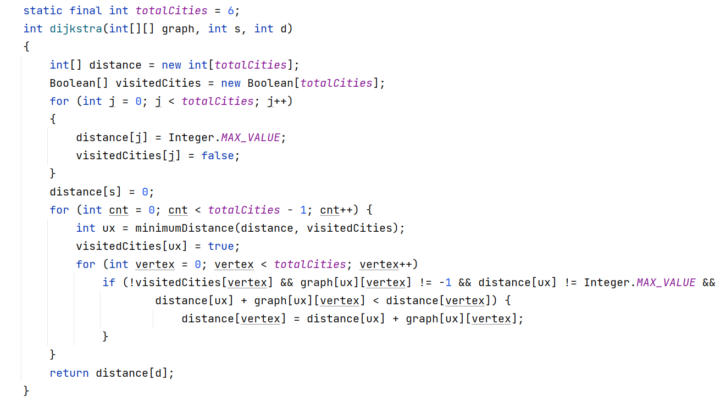
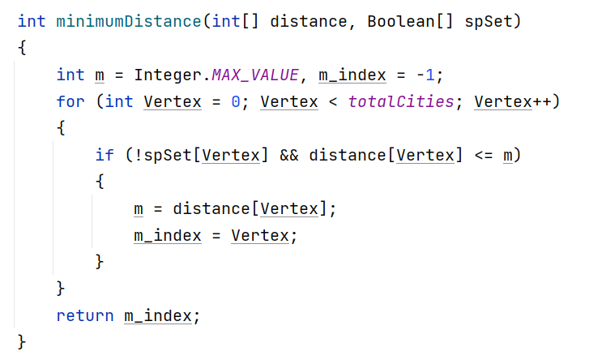
JUST-IN

Slide 5
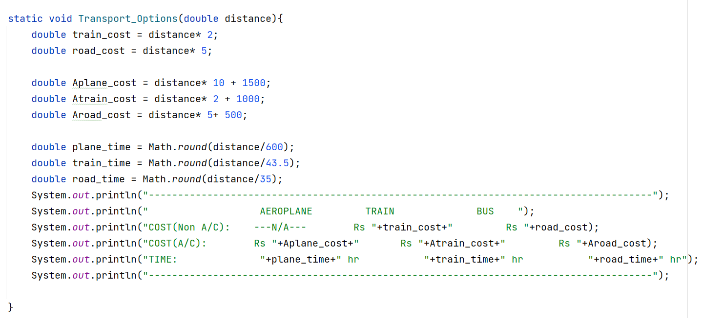

Slide 6
